Slide 1
Business Management
Alyssa, Zoe, Jose, Jorge, Diego

Slide 2
What college did you attend? Why?
UC Santa Barbara
This school had the major i was looking for (Project Management)
Project Management had 12 courses
What is project management?
Project Management skills are a universal tool for almost every career and industry. The courses here enable you to acquire the skills needed to keep projects on task, on time, and on budget.

Slide 3
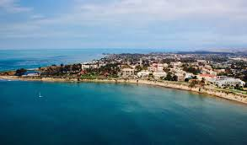
What was your major?
My major was project management
to get the degree i had to pass all 12 courses
The 12 courses were
introduction to project management
project initiation, planning, and integration
project scope, cost, and time management
quality and risk management for project management
project management practicum
practical project management
human factors in project management
fundamentals of practical project management
agile project management
project stakeholder management
PMP Exam Prep workshop
managing projects when things go wrong

Slide 4
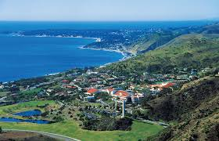
At UCSB
How many years of schooling did I do?
there was a total of 4 years. Within those 4 years at UCSB, I was learning about what I was very passionate about, which is working with people, changing the community in a positive way, etc…
What was the degree I had earned once I graduated from UCSB?
Since I only attended UCSB for 4 years, I only earned my bachelor's degree in project management.

Slide 5
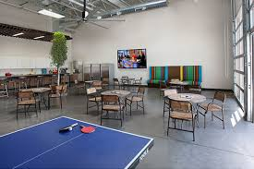
What is your profession? How much is your yearly income?
Yearly I could make anything from $35,000 to $75,000 a year, depending on how well the business is and what my product of business is
My profession is a business owner and I run my own shop/company

