Slide 1
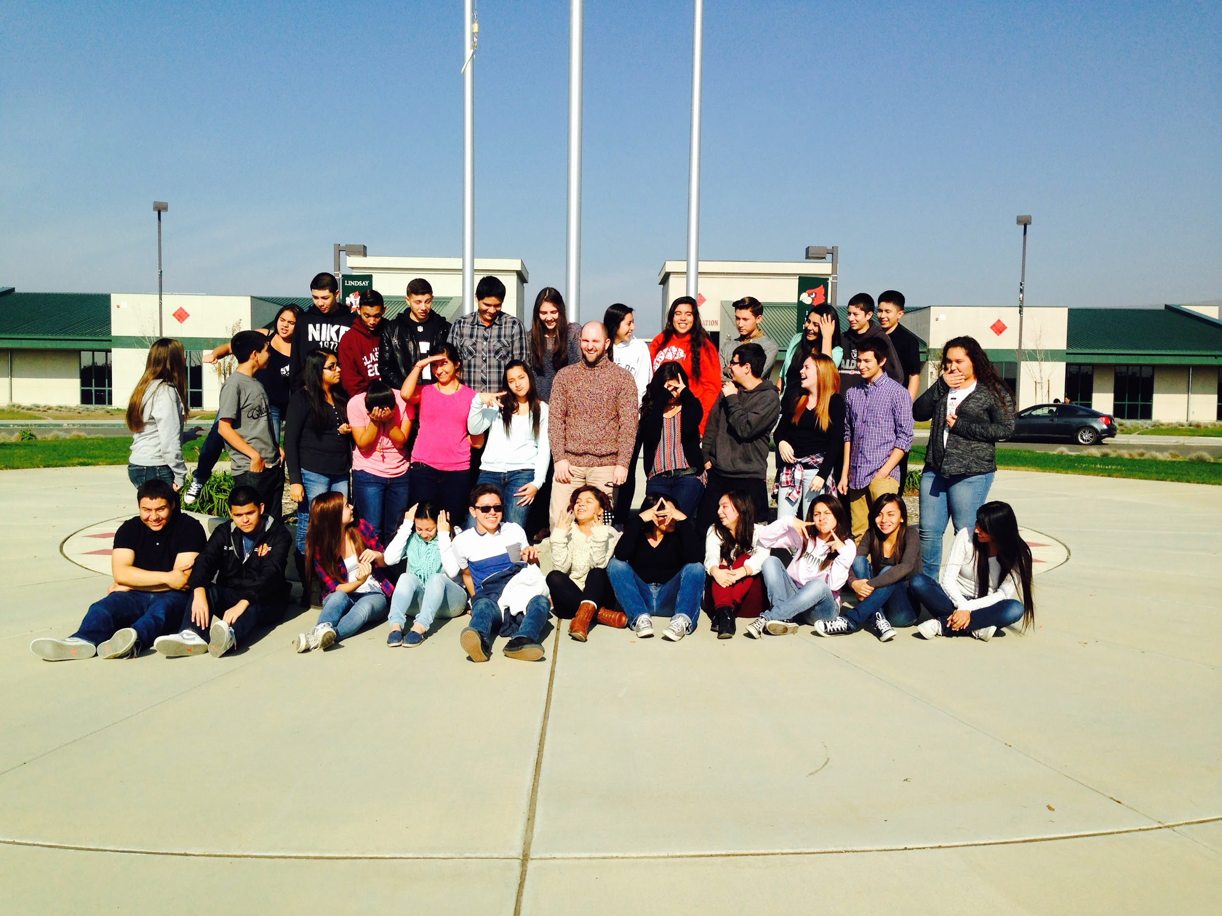
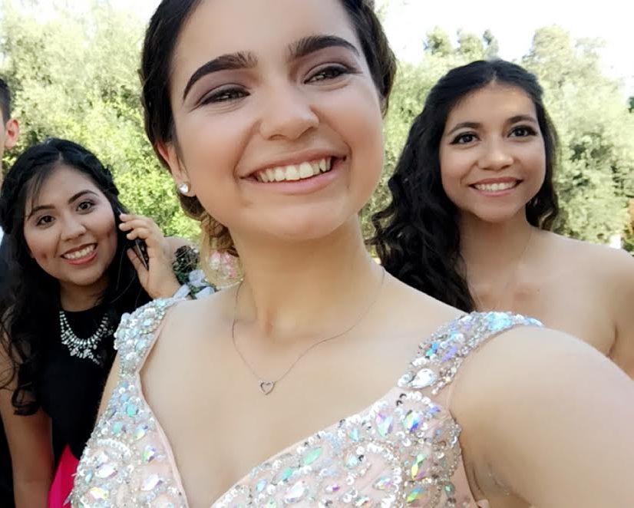
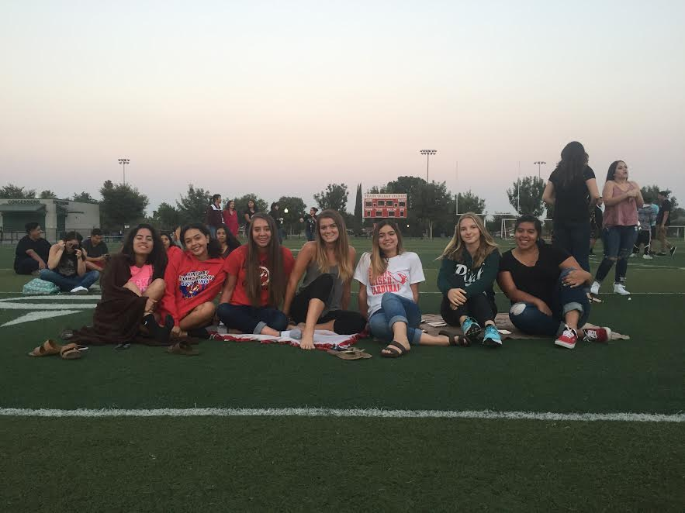
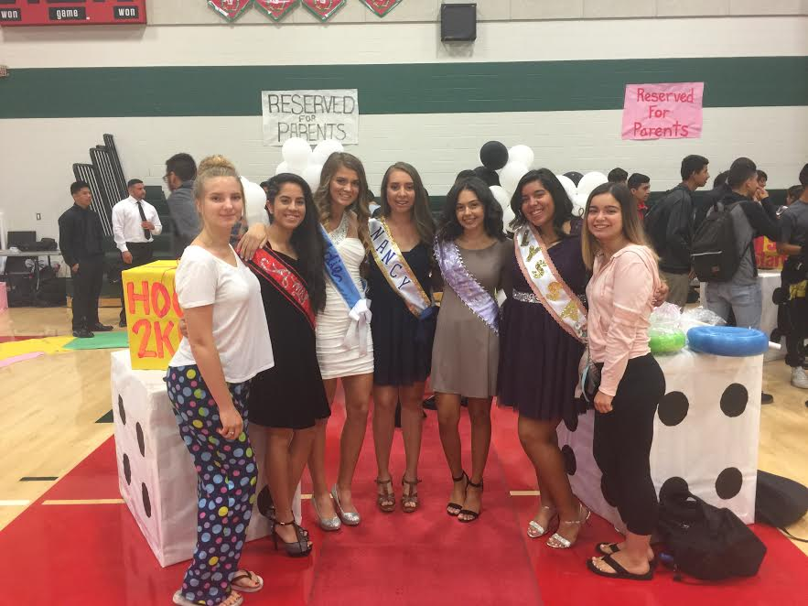
Senior Exit Interview
Zoe Reser

Slide 2
About Me
Middle child of a divorced family
Have an older brother, younger sister, & baby brother
My skills are planning events & being a leader
Never had a stable home environment
Moved 15 times since 8th grade

Slide 3
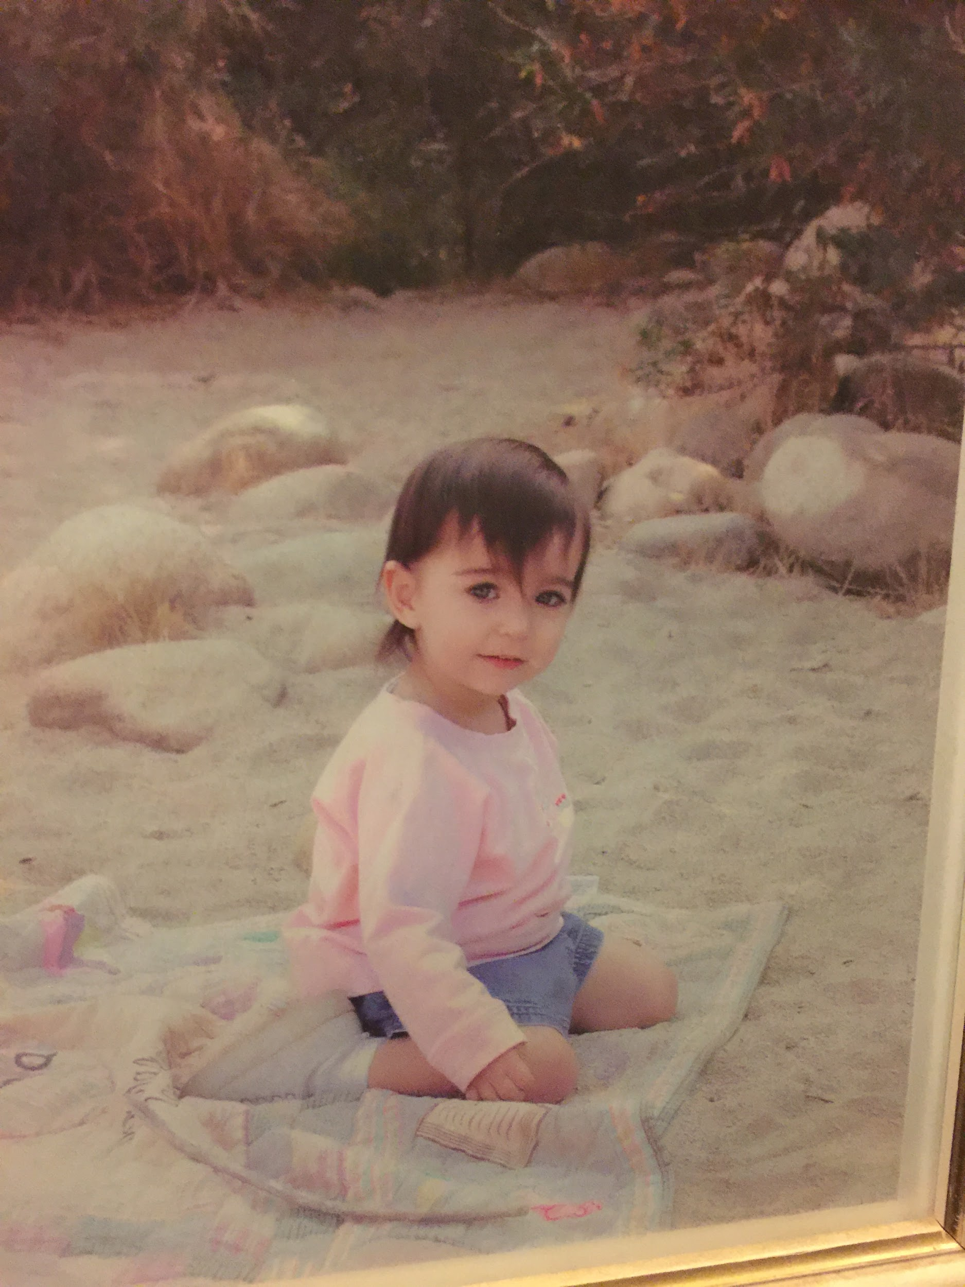
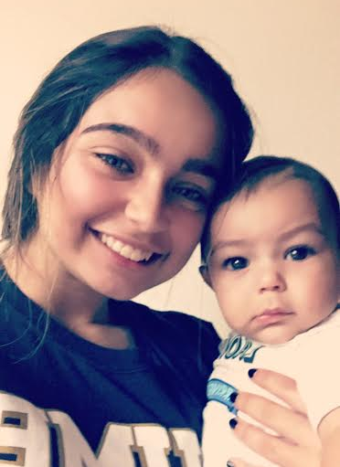
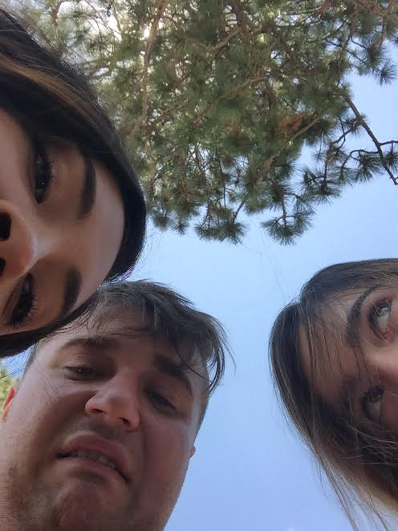
Me as a baby, my baby brother, and my brother and fiance at Yosemite

Slide 4
High School Experience
Most active clubs/programs are
AVID, ASB, Team Empower/Lindsay Leads
Other clubs are
Drama, FBLA, Adventure Club, French Club, Key Club, Prom Committee, Homecoming Committee, and Track
Freshman year: struggled with pacing and PBS
High School has motivated and allowed me to understand I can achieve great things

Slide 5
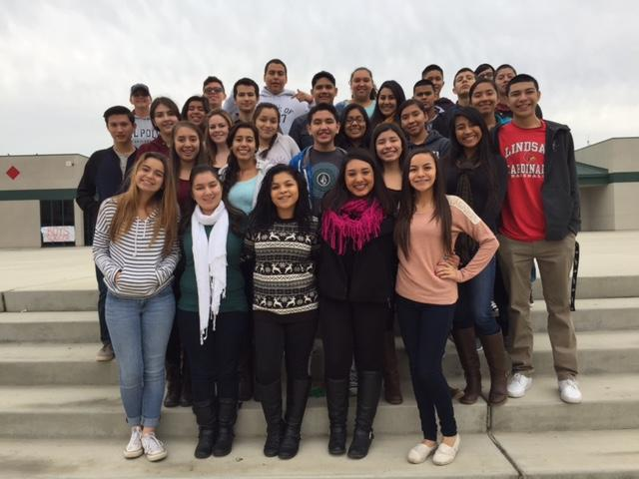
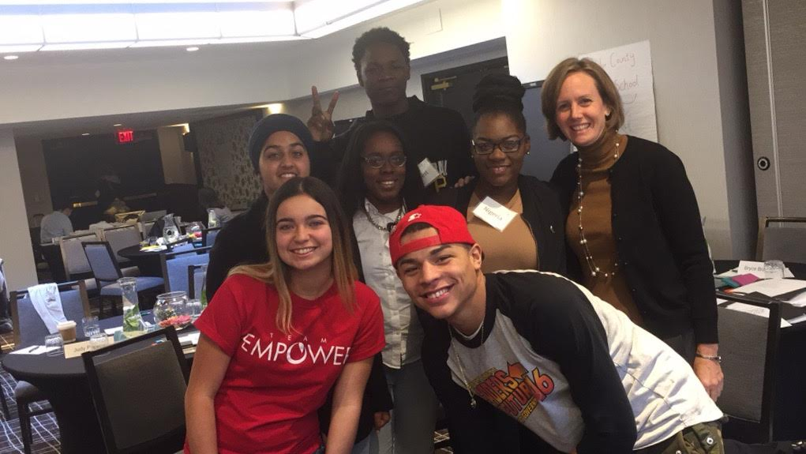
-AVID
-Senior Sunrise
-Sparkhouse Conference

Slide 6
Job Shadow
Co-owner of Papa Murphy’s for Visalia and Tulare
Helpful due to desire of wanting to pursue a career as an Entrepreneur
The shocking part: yearly training to improve your skills as a boss and leader
Similar to my ASB class was to running a business

Slide 7
Pathway
French Language, chose this pathway due to scheduling conflicts
Could be helpful having an unusual language when dealing with customers
Taught me that I can’t always have what is beneficial immediately but can learn how to work with it

Slide 8
Post High School Plans
1 year from now:
Attend 4 year university: General Business Major, top two choices are SJSU & CSUMB, part time job to slowly help with loans
5 years from now:
Have my degree from SJSU, have my loans deferred temporarily, Peace Corps
10 years from now:
Work as a personal assistant for someone until financially stable, start my own business

Slide 9
Leaving Lindsay High
Plan on attending S.J.S.U.: General Business major
Lindsay High shaped me into an empowered learner
Being in Lindsay with our system, learned about accountability & became responsible for my own learning

Slide 10
Any questions or comments?
Thank you

